Slide 1

PROJET TITLE EMOJIFY

Slide 2
REVELANCE OF TOPIC
Emojis or avatars are ways to indicate nonverbal cues. These cues have become an essential part of online chatting, product review, brand emotion, and many more. It also lead to increasing data science research dedicated to emoji-driven storytelling. Emojis help substitute some of the missing tone of voice, body language, or facial cues that ensure meaning isn't lost or misconstrued
With advancements in computer vision and deep learning, it is now possible to detect human emotions from images. This deep learning project classify human facial expressions to filter and map corresponding emojis or avatars.

Slide 3
Description of the Project
An emoji is a pictogram, logogram, ideogram or smiley embedded in text and used in electronic messages and web pages. The primary function of emoji is to fill in emotional cues otherwise missing from typed conversation.
Project built by using mediapipe and keras,also opencv and streamlit is used to create a webapp. Capturing the face is done by webcam.
In this deep learning project, we are building a system for recognizin facial emotions. We are training the model by the FER2013 dataset. Then we are mapping those emotions with the corresponding emojis or avatars.

Slide 4
Input / Output and Code Description

Slide 5
This project takes in live video feed and converts the input feed to predicted emoji.
This is live emoji predictor based on input given data.
The keypoints of face,are detected and extracted .
Then these keypoints are collected as saved as numpy file. Later in the training part these saved keypoints are given to the dense neural network for training part.
After that of training the model is saved.
Then in the inference the model is loaded and same way keypoints are extracted and given as input to the model for the prediction. That is all about the working of this project.

Slide 6
Creating files
Collecting some data
Coding data loading part
Encoding y {String to Int}
Building model
Training Model
Shuffling Data
Saving model and labels
Coding Inference part
Final OutputAdding and training

Slide 7
1. Face detection
Locating faces in the scene, in an image or video footage.
2. Facial expression and emotion classification
Analyzing the movement of facial features and/or changes in the appearance of facial
features and classifying this information into expression-interpretative categories such as
facial muscle activations like smile or frown; emotion categories happiness or anger;
attitude categories like (dis)liking or ambivalence.

Slide 8
Datasets The FER2013 dataset ( facial expression recognition) consists of 48*48 pixel grayscale face images. The images are centered and occupy an equal amount of space. This dataset consist of facial emotions of following categories: 0: angry 1:disgust 2:feat 3:happy 4:sad 5:surprise 6:natural

Slide 9
Facial Emotion Recognition Algorithm
HaarCascade algorithm is one of the most powerful algorithms for the detection of objects specifically face detection in OpenCV
used to identify objects in an image or video and based on the concept of ​​ features proposed by Paul Viola and Michael Jones
adaboost frontal face detector created by Rainer Lienhart.

Slide 10
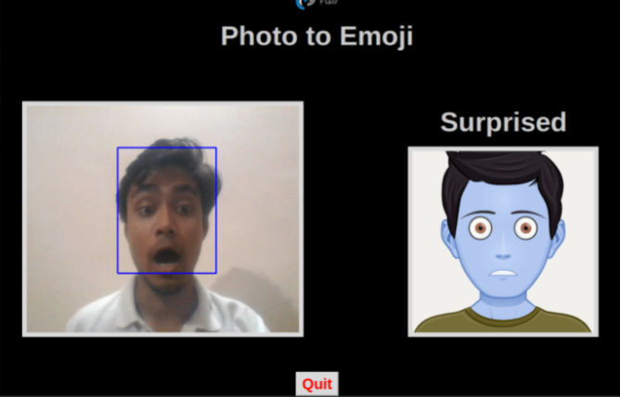
Using openCV haarcascade xml detect the bounding boxes of face in the webcam and predict the emotions
They were working with OpenCV based eye detector that uses Haar feature-based cascade classifiers around 89% accurate on their images.

Slide 11
UI Design & Implementation

Slide 12
HTML,CSS is also used to add more user experiences

Slide 13
Sample Screen Shots

Slide 15
Future Scope of the Project.

Slide 16
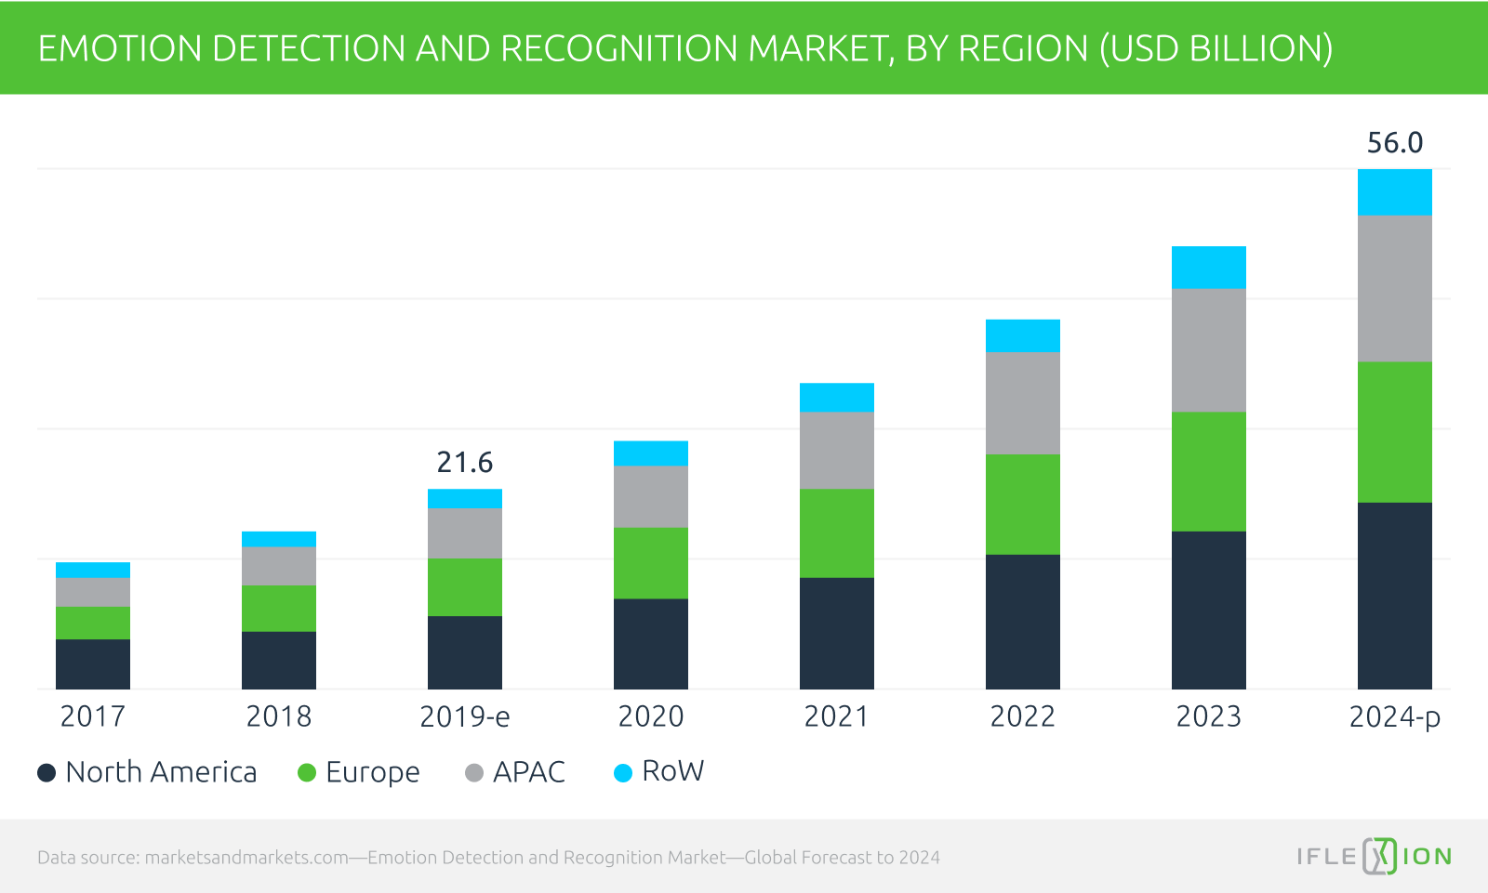
Emotion recognition has wide scope in many areas such as human computer interaction, biometric security etc. So it provides insight into artificial intelligence or machine intelligence that uses various supervised and unsupervised machine-learning algorithms to simulate the human brain.

Slide 17
Emotion recognition in Health Care
Automotive industry and emotion recognition
Emotion recognition in video game testing
Metaverse

Slide 18
THANK YOU

